Slide 1
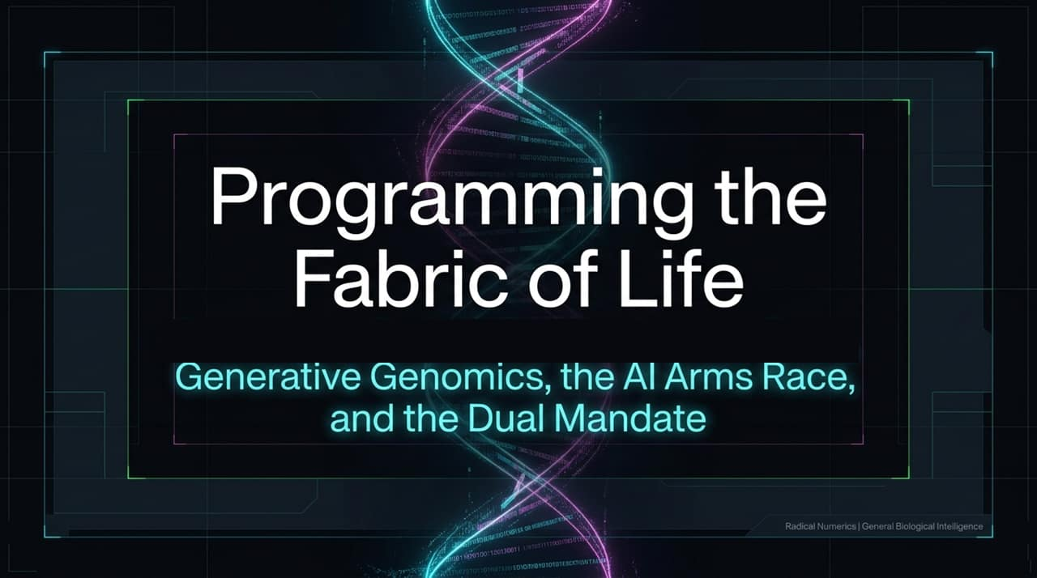
Notes:
Good morning, everyone. Welcome to today’s session on what we believe is the next big frontier in artificial intelligence: Generative Genomics and General Biological Intelligence.
When we look at the trajectory of AI over the past few years, the primary paradigm has been Natural Language Processing—training models on human words, code, and images. But parallel to this, there is another fundamental language: the raw, unannotated code of biology—DNA.
At Radical Numerics, our founding vision is built on the realization that AI shouldn't just read DNA; it should write it, reason with it, and predict its cellular impact. However, as we unlock the power to generate novel biological constructs—from engineered enzymes to synthetic viral genomes—we face an urgent dual reality. The exact same technological capabilities that allow us to model complex human diseases can also lower the technical barrier to designing dangerous pathogens.
This brings us to our Dual Mandate: As a frontier AI research lab, we hold ourselves responsible for advancing state-of-the-art biological design capabilities while simultaneously building robust, frontier-grade biodefense and surveillance tools to safeguard that technology. Today, we'll walk through how we transitioned from early context-efficient models to foundational models like EVO and Omni, and how we are addressing the biosecurity arms race head-on.
Applying Chain-of-Thought to DNA??? - Eric Nguyen (CEO, Radical Numerics)
https://www.youtube.com/watch?v=B7DdNj_VjcU

Slide 2
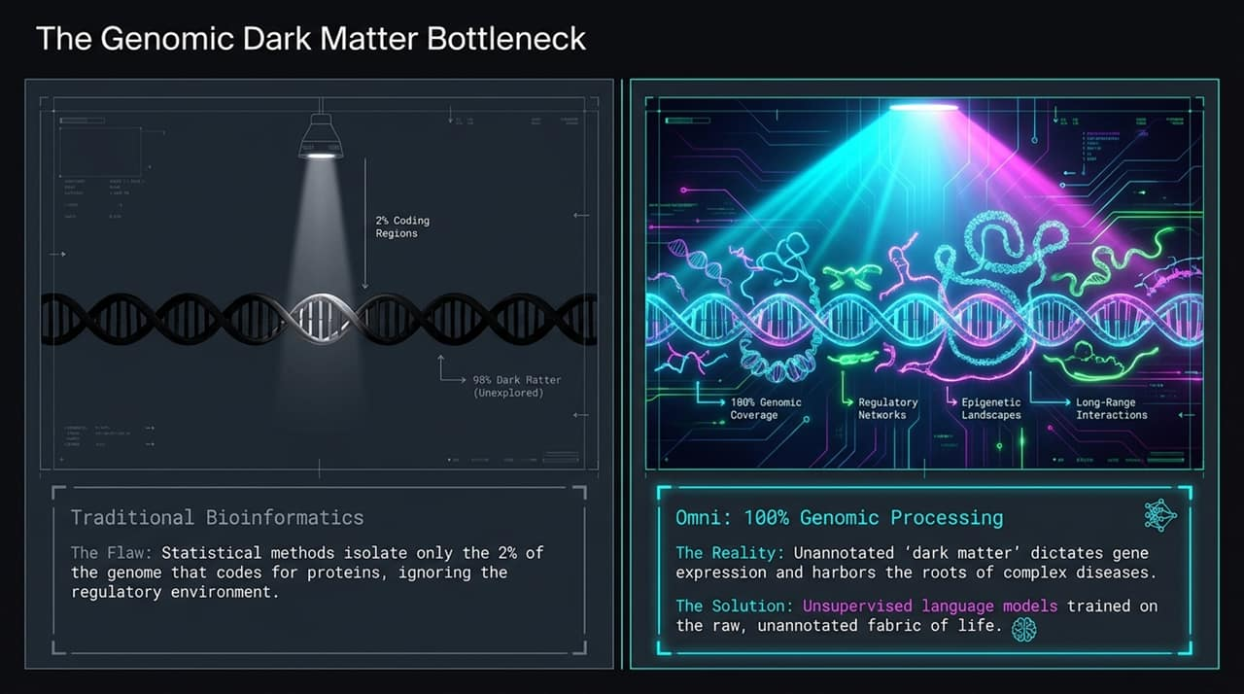
Notes:
To understand why we need large biological language models, we first have to look at the fundamental bottleneck of traditional bioinformatics.
For decades, the vast majority of biological research has focused almost exclusively on coding regions—the roughly 1.5% to 2% of the human genome that directly encodes proteins. Traditional bioinformatics tools rely heavily on statistical methods and hand-annotated labels, effectively treating the remaining 98% of the genome as unannotated dark matter or junk DNA.
Here is the flaw: that 98% is not junk. It houses the regulatory networks, epigenetic landscapes, and long-range chromosomal interactions that dictate when, where, and how much genes are expressed. The roots of many complex human diseases, rare conditions, and variants of unknown significance (VUS) lie squarely within these unannotated non-coding regions.
Supervised models fail here because annotating 3 billion base pairs manually across all human cell types is practically impossible. This is where unsupervised language models change the game. By pre-training models directly on raw, unannotated genomic sequences across thousands of species, the AI learns the underlying grammar, regulatory constraints, and evolutionary rules of life from the raw substrate itself. Our newest architecture, Omni, achieves 100% genomic processing, overcoming this bottleneck completely.

Slide 3
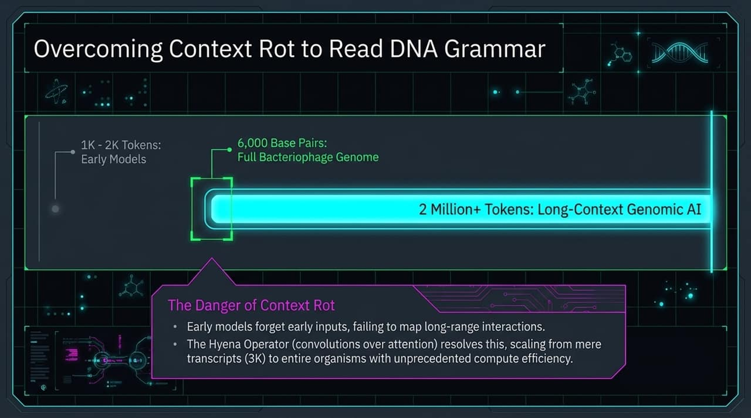
Notes:
When applying Large Language Models to genomics, the biggest technical hurdle isn't vocabulary—DNA only has four primary characters (A, C, G, T)—it is context length.
In natural language, a few thousand tokens are often enough to capture the meaning of a paragraph or document. But DNA operates on a completely different spatial scale. A standard human transcript might be 3,000 base pairs, an entire bacteriophage genome around 6,000 base pairs, while regulatory elements in humans can interact across hundreds of thousands or millions of base pairs.
Early genomic models suffered severely from Context Rot. As sequence inputs grew longer, standard self-attention mechanisms in Transformers experienced quadratic memory scaling ($O\left(N^{2}\right)$) and degraded performance over distance, effectively forgetting early tokens and failing to resolve long-range interactions.
To solve this, our team developed the Hyena Operator—replacing quadratic attention with sub-quadratic long convolutions. This enabled us to scale context windows from a meager 1K–2K tokens all the way past 2 Million+ tokens with unprecedented compute efficiency. This breakthrough allowed genomic AI to move from reading short sequence fragments to analyzing entire gene networks and organism-scale DNA grammar in a single forward pass.

Slide 4
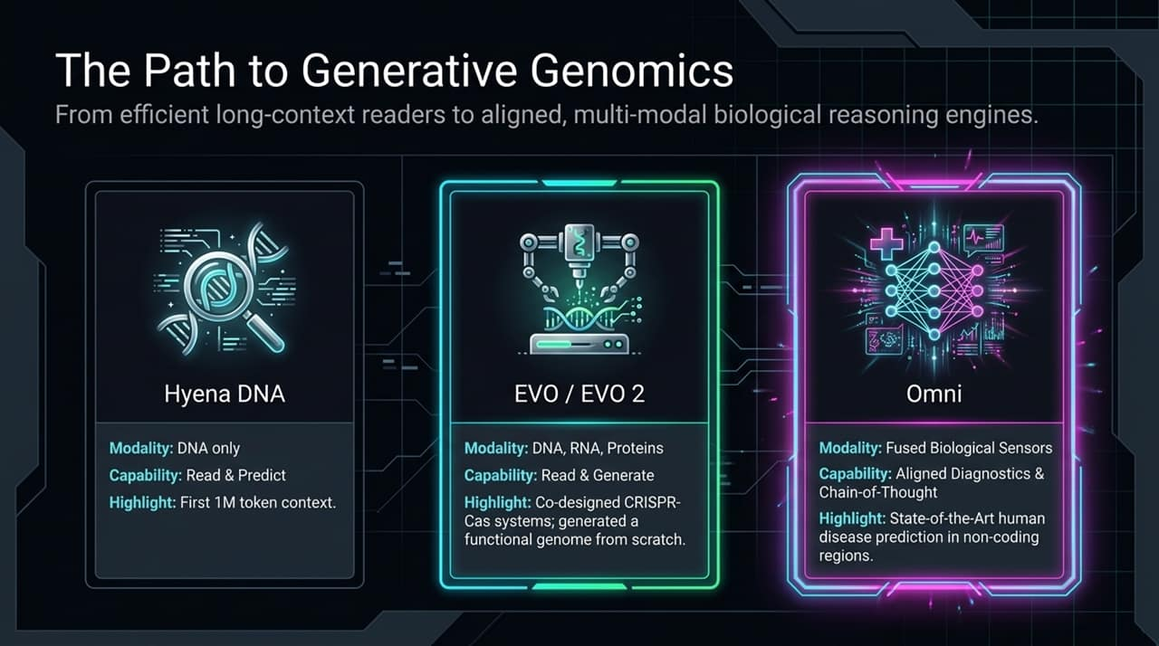
Notes:
Let’s walk through our technical evolution across three major model generations.
First came Hyena DNA. Its primary focus was single-modality (DNA only) context scaling. It was a reader and predictor model, demonstrating for the first time that a 1-million-token context window could capture long-range regulatory patterns without attention degradation.
Next was EVO and EVO 2, which truly kicked off the era of Generative Genomics. Instead of just reading DNA, EVO was trained autoregressively to write DNA. Because DNA is the master template from which RNA and proteins are translated, training at the DNA level allowed EVO to operate multi-modally. EVO made headlines by co-designing multi-component CRISPR-Cas systems—complexes containing both protein enzymes and RNA guides—from a single foundation model. Even more dramatically, scientists used EVO to generate a functional biological genome (a bacteriophage virus) from scratch—a feat impossible using conventional bioengineering.
Now, we introduce Omni. Omni represents the leap from generation to aligned multi-modal biological reasoning. It fuses biological signals, mid/post-training alignment, and chain-of-thought capabilities, pushing state-of-the-art performance in human disease prediction, especially within those critical non-coding regions.

Slide 5
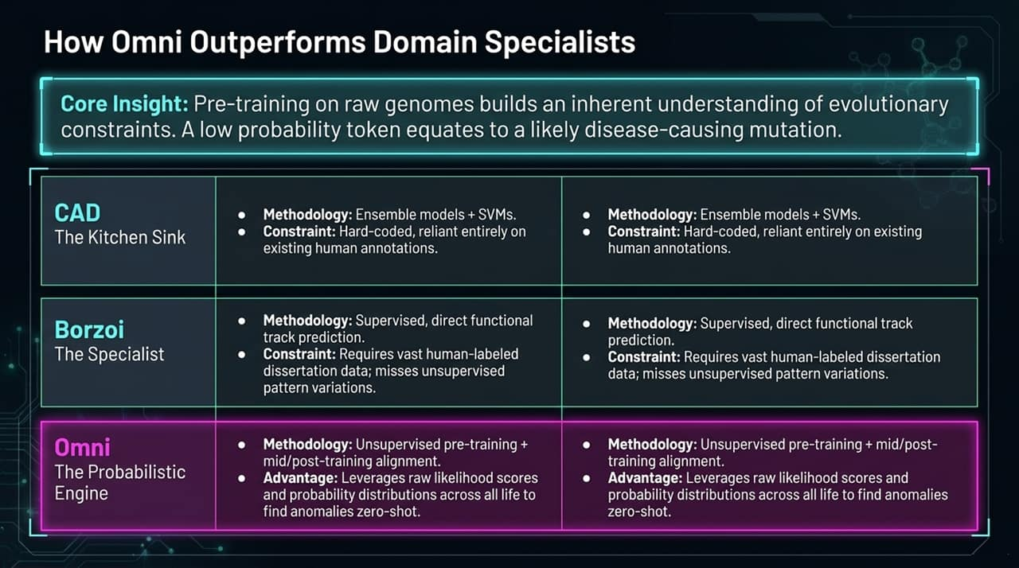
Notes:
A recurring debate in computational biology has been: Why use a massive, generalist Foundation Model when small, hyper-specialized domain models exist?
Until recently, specialist models often outperformed generalist biological LLMs on specific human benchmark tasks. Consider CADD (Combined Annotation Dependent Depletion), which has long been the gold standard for variant effect prediction. CADD achieves its performance by using an ensemble approach—throwing the kitchen sink at the problem by combining Support Vector Machines, statistical tools, and smaller supervised networks.
Omni changes this paradigm. The core insight behind Omni is that pre-training on billions of years of raw evolutionary sequences builds an inherent, probabilistic understanding of structural and functional constraints. When a mutation occurs in a functional DNA region, the model assigns a low probability to that token relative to the wild-type. This probability drop acts as a natural metric for functional disruption or pathogenicity.
By applying structured mid-training and alignment, Omni outperforms both previous genomic foundation models and complex supervised ensembles like CADD across a broad spectrum of human variant benchmarks without requiring task-specific fine-tuning heads.

Slide 6
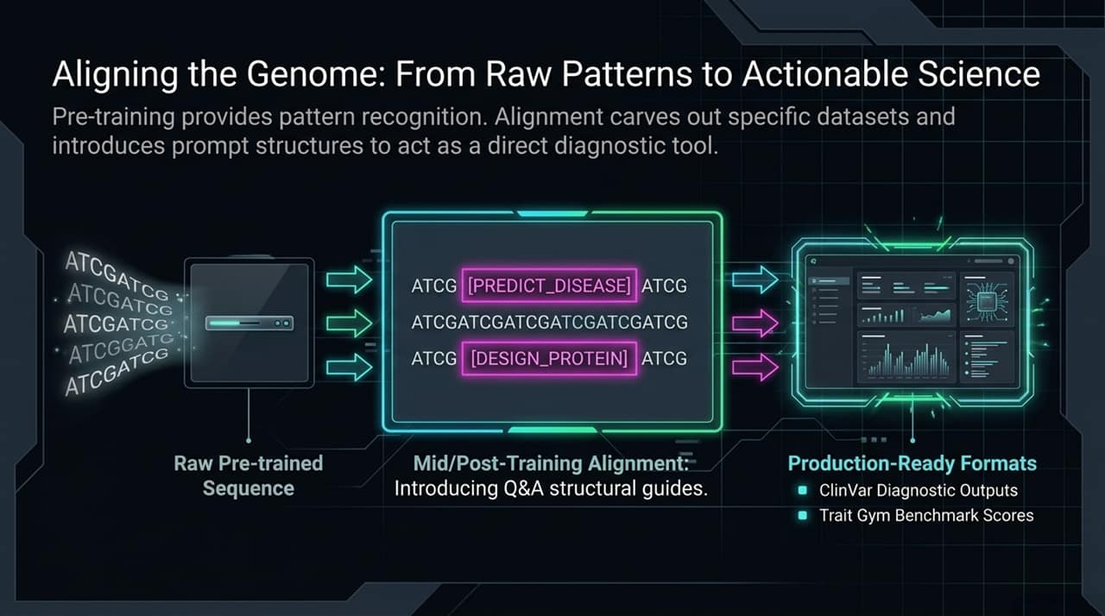
Notes:
Let's look at the empirical data. On standard clinical benchmarks—such as ClinVar and TraitGym—which evaluate a model's ability to distinguish pathogenic disease-causing variants from benign mutations, Omni establishes a new state-of-the-art.
Earlier zero-shot models like EVO 2 demonstrated impressive breadth across microbial biology but lagged on human genetics due to the extreme noise and complexity of the human genome. Supervised models like Borzoi predict direct functional tracks (like chromatin accessibility) using annotated data, but they are limited to the specific tasks they were explicitly trained on.
Omni bridges these worlds. By combining unsupervised likelihood scoring with structured prompt-based mid-training, Omni matches or beats heavily supervised ensemble baselines. Crucially, our team implemented rigorous bioinformatics de-duplication and data-cleaning pipelines to prevent data leakage between training corpora and clinical benchmarks, ensuring that Omni’s superior performance reflects genuine biological generalization rather than memorization.

Slide 7
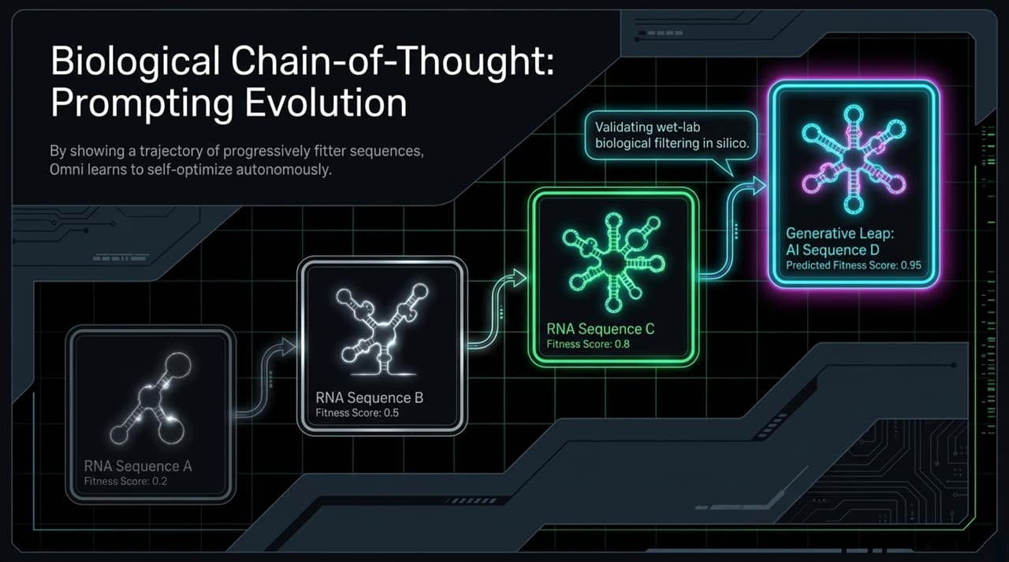
Notes:
What does this benchmark performance mean in practice for real-world medicine?
Every day, hospital systems, pediatric geneticists, and clinical labs run whole-genome sequencing on patients with severe, unexplained rare diseases. In a massive number of cases, doctors identify hundreds of mutations but are forced to categorize them as Variants of Unknown Significance (VUS). They simply don't know which mutation is driving the patient's symptoms because the variant sits inside a non-coding regulatory region.
Because Omni excels at interpreting non-coding DNA grammar and long-range regulatory logic, it provides clinicians with high-confidence probability scores for VUS candidates. By pinpointing causal regulatory variants, Omni helps bridge the gap between raw sequencing data and actionable clinical diagnosis, offering answers to families who have spent years on diagnostic odysseys.

Slide 8
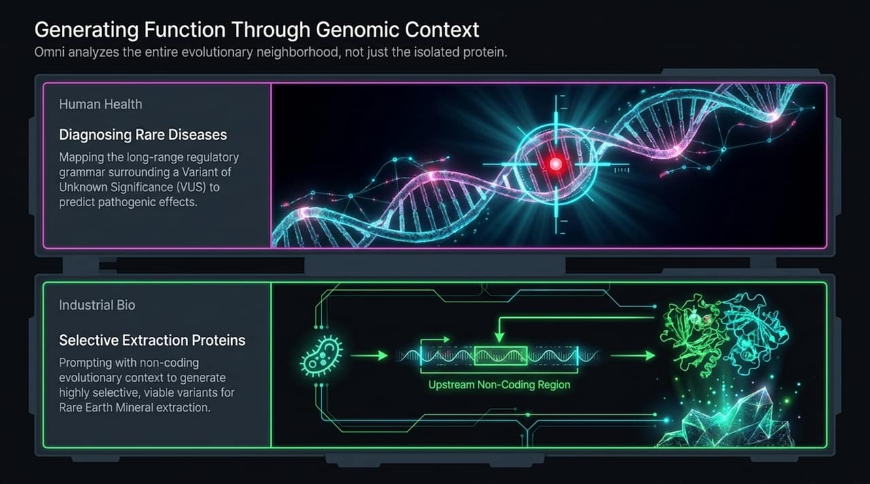
Notes:
In natural language AI, Chain-of-Thought (CoT) prompting revolutionized reasoning by forcing the model to show its work step-by-step before arriving at an answer. But what does Chain-of-Thought look like in genomics, where there are no natural English intermediate words?
We developed a novel paradigm for biological CoT. Instead of text tokens, we format intermediate reasoning steps as trajectories of progressively improving biological sequences paired with fitness scores.
In a benchmark experiment using RNA aptamers—short RNA sequences engineered to bind target molecules—we presented Omni with a prompt containing sequences ordered from low binding affinity to moderate affinity. We then asked Omni to continue the generation sequence.
Rather than generating at random, Omni learned the trajectory curve and generated novel RNA aptamers with predicted binding scores that exceeded the best samples in the prompt. Essentially, Omni performed in-silico directed evolution in a single autoregressive step, demonstrating that generative reasoning paradigms can directly optimize biological fitness.

Slide 9
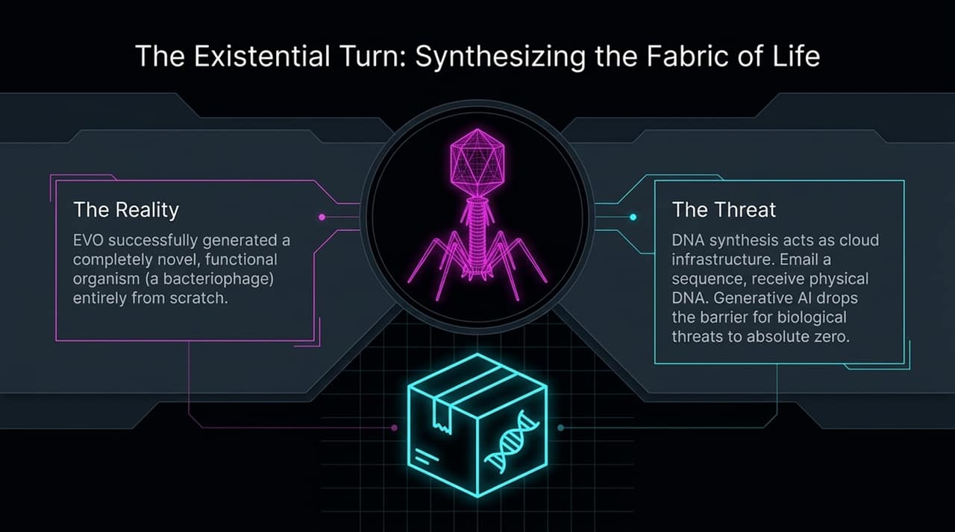
Notes:
The flexibility of Biological Chain-of-Thought extends far beyond conventional therapeutics.
For example, we are collaborating with national laboratories on industrial and environmental design tasks, such as engineering proteins for selective rare-earth mineral extraction. Mining critical minerals like neodymium or dysprosium requires environmentally toxic chemical separation. Microorganisms, however, possess proteins that can bind specific metals with extreme selectivity. By feeding Omni context sequences from metal-binding operons and prompting it with fitness trajectories, Omni can generate novel, highly selective protein variants to clean up supply chains.
Similarly, in medicine, we apply this to counter Antimicrobial Resistance (AMR). Bacterial superbugs cause over two million deaths globally each year. By generating synthetic bacteriophage (phage) viral components tuned to selectively infect and destroy target antibiotic-resistant bacteria, Omni acts as a platform for personalized antimicrobial design.

Slide 10
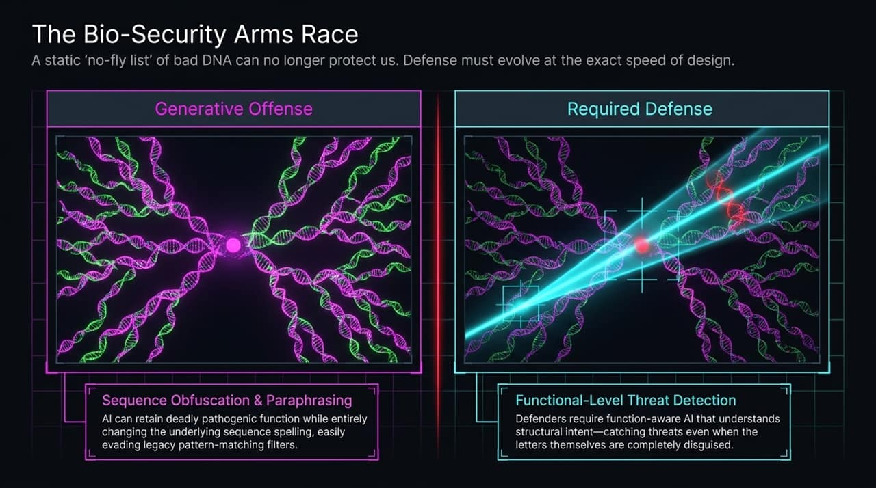
Notes:
As we demonstrate these powerful design capabilities—generating viral genomes, engineering aptamers, and optimizing protein functions—we must confront the biosecurity reality.
The fundamental truth of biological AI is that generative models and predictive discriminator models share the exact same underlying representations. A model that understands how to design novel function into a sequence is mathematically the same model best equipped to recognize, flag, and neutralize potential pathogenic threats.
Many AI labs treat biosecurity as an afterthought, relying on simple text filters at the prompt level. But text filters don't inspect raw DNA sequences or physical DNA synthesis orders. At Radical Numerics, our Dual Mandate dictates that every advance in generative capability must be matched by an equal advance in biodefense and biosecurity screening. We build tools to monitor, attribute, and defend against the very capabilities we enable.

Slide 11
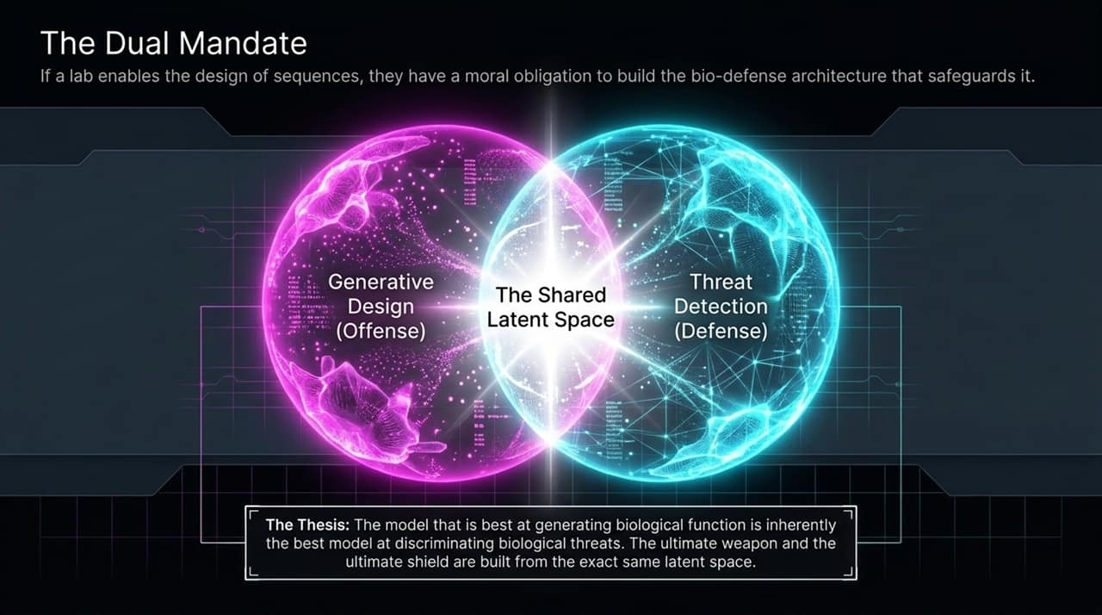
Notes:
To understand the biosecurity challenge, we must look at how biodefense operates across four primary pillars: Detection, Attribution, Countermeasures, and Deterrence.
Historically, biodefense surveillance—such as testing wastewater or airport environmental swabs—relied on exact sequence alignment. Systems took a sample and matched it against a static database of known threat pathogens.
However, modern generative AI creates a massive vulnerability: Functional Paraphrasing. Just as an LLM can rephrase an English sentence using totally different vocabulary while preserving its meaning, a genomic model can modify a pathogen’s DNA sequence so that traditional alignment tools fail to recognize it, even while its deadly biological function remains fully intact.
To defend against this, modern biosecurity requires AI models that evaluate sequences based on functional and structural space rather than strict letter matching. By deploying biological foundation models into DNA synthesis provider pipelines and environmental monitoring networks, we can detect obfuscated threats, attribute their evolutionary origin, and rapidly generate countermeasure treatments.

Slide 12
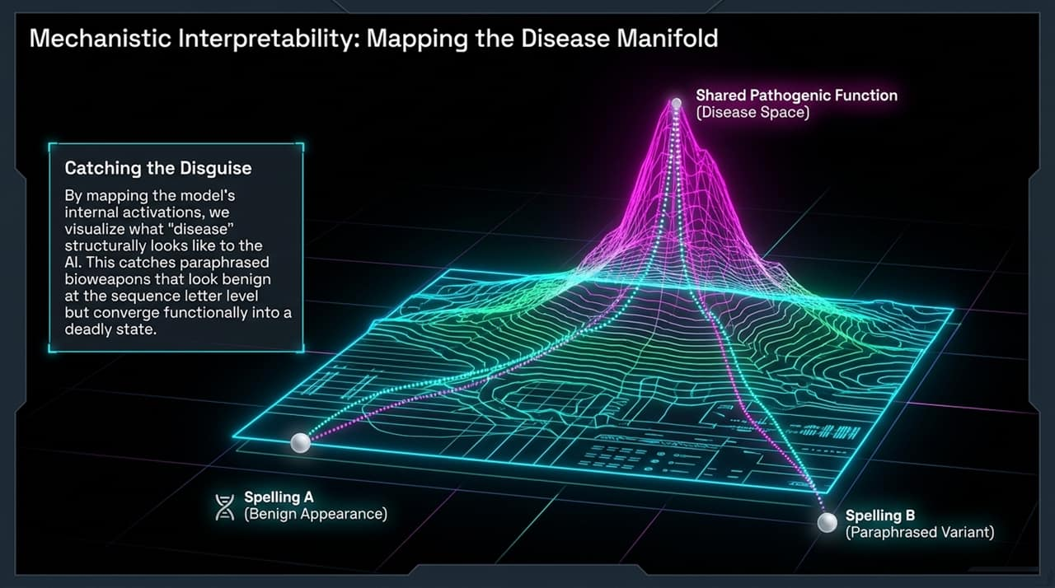
Notes:
To trust AI models in clinical diagnostics and national security, we cannot treat them as black boxes. We need Mechanistic Interpretability (MechInterp) for biology.
By probing Omni’s internal layer activations and embeddings, we can uncover how the model organizes biological knowledge. For example, when inspecting intermediate representations, we see distinct activation clusters corresponding to specific biological features: GC content variations, chromatin accessibility markers, and complex Transcription Factor (TF) binding motifs.
Transcription factors are proteins that bind to DNA to turn genes on or off. Understanding how Omni's neural network internalizes these TF motifs allows us to extract new biological insights directly from the model's weights. Instead of just using AI to answer questions, we are using interpretability to discover previously unknown biological rules encoded within the genome.

Slide 13
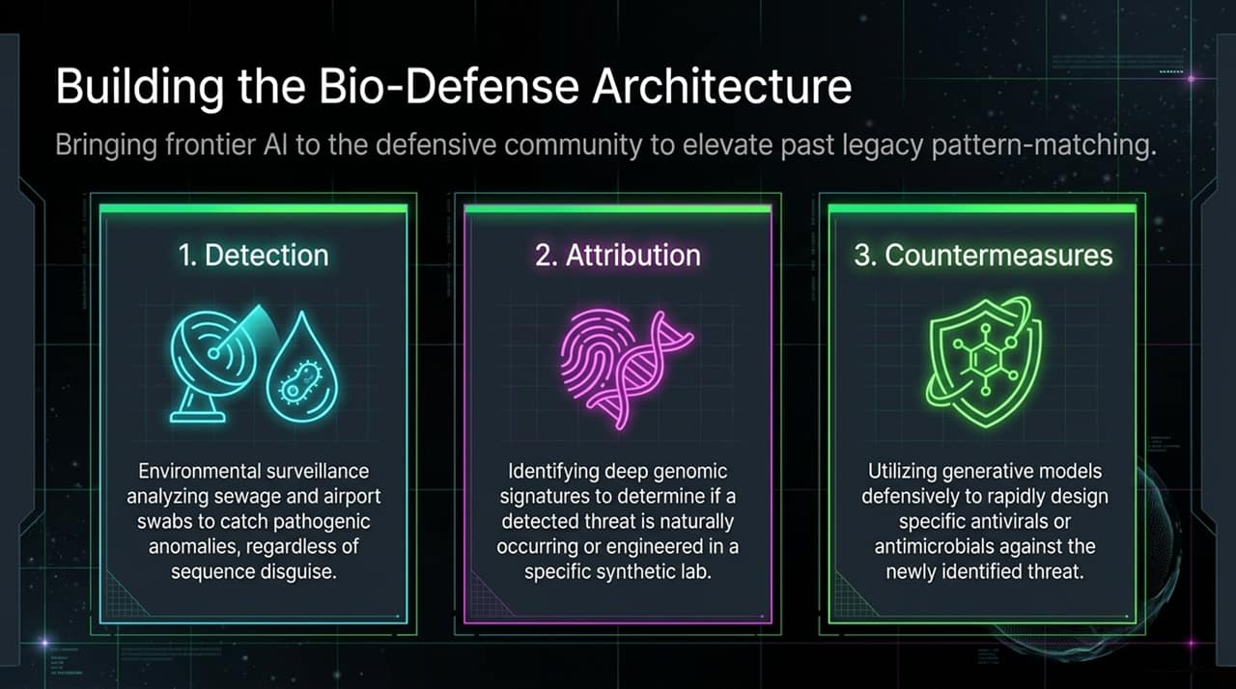
Notes:
Taking interpretability a step further brings us to the concept of Mapping the Disease Manifold.
Imagine a high-dimensional geometric space where every possible genomic sequence occupies a specific point. Healthier, wild-type sequences form dense, stable regions, while pathogenic mutations push sequences out toward specific disease frontiers.
By mapping Omni’s embedding space, we can visualize the topological relationships between different diseases. Variants that cause similar physiological disruptions cluster near each other on the manifold, even if they occur on entirely different chromosomes. This global view of disease space allows researchers to discover shared disease mechanisms, identify multi-disease drug targets, and predict how subtle combination mutations might shift a patient's overall health trajectory.

Slide 14
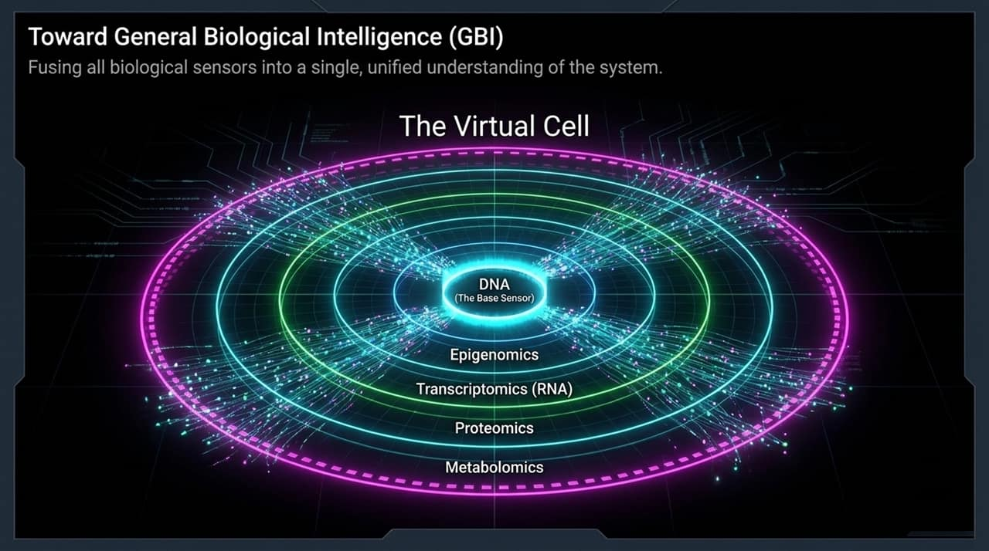
Notes:
Where is all of this heading? Our ultimate goal at Radical Numerics is General Biological Intelligence (GBI).
In AI, human-level intelligence requires multi-modal sensing—text, vision, audio, and physical feedback. Biology is no different. DNA is the master blueprint, but a complete living system requires multi-sensor fusion.
True biological intelligence cannot rely on DNA alone, nor can it rely solely on single-cell RNA sequencing or protein folding models. GBI requires unifying all biological sensors into a single foundational model: fusing DNA genomics, RNA transcriptomics, epigenomic methylation patterns, ATAC-seq chromatin openness, and cellular proteomics.
When you fuse these modalities together across scales—from individual nucleotides to whole cells and organ systems—you move beyond narrow specialized predictors. You create a holistic biological foundation model capable of simulating cellular responses, predicting systemic drug efficacy, and reasoning across the entire tree of life.

Slide 15
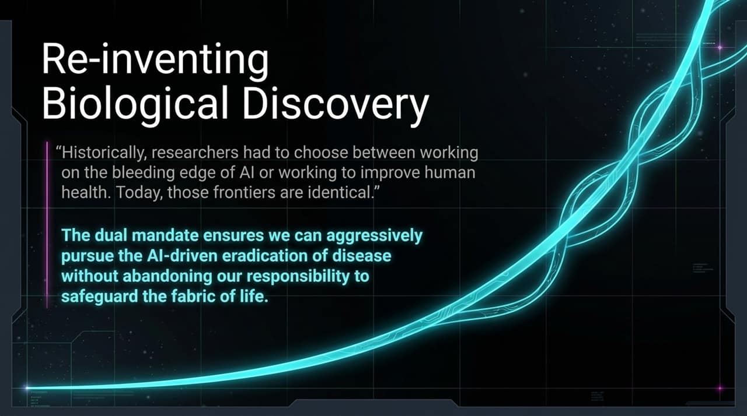
Notes:
Achieving long-context multimodal intelligence requires deep innovations at the lowest levels of the compute stack. You cannot build frontier biological AI by simply running off-the-shelf Transformer scripts on standard GPU clusters.
Our team approaches model building through Hardware and Algorithmic Co-Design. We dive directly into GPU hardware architecture, writing custom CUDA and Triton kernels tailored specifically to sub-quadratic operators like Hyena.
DNA sequences do not behave like natural text; they require massive memory throughput and long-sequence parallelization. By optimizing SRAM usage, flash-attention variants, and custom state-space operations on modern GPU architectures, we eliminate compute bottlenecks. This hardware-level efficiency is what allows us to train models over million-token context windows at a fraction of the compute cost that standard attention architectures would demand.

Slide 16
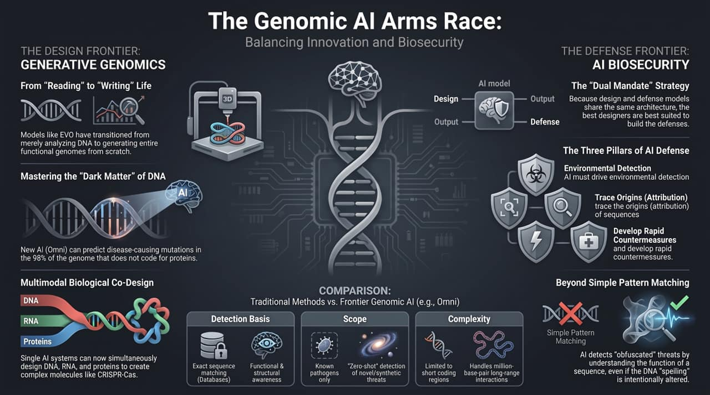
Notes:
To wrap up: We are at a historic inflection point in the convergence of AI and biology.
For a long time, researchers felt they had to make a choice: either work on the bleeding edge of AI technology at consumer software companies, or work on meaningful biological problems using older, second-tier ML tools. Today, that compromise no longer exists. Biology is the frontier of artificial intelligence.
By scaling context windows, introducing biological chain-of-thought, and unifying multi-modal cellular data, models like Omni are changing how we diagnose disease, engineer enzymes, and understand life itself. And by holding ourselves to our Dual Mandate, we ensure that as biological AI becomes infinitely more capable, our biodefense and surveillance infrastructure stays one step ahead.
Thank you for your time, and I look forward to taking your questions.
Applying Chain-of-Thought to DNA??? - Eric Nguyen (CEO, Radical Numerics)
https://www.youtube.com/watch?v=B7DdNj_VjcU

